Slide 1
SOFTWARE DEVELOPMENT 3
Exceptions Part 2

Slide 2
Handling Multiple Exceptions
Any code that we place in the try block may be capable of throwing more than one type of exception.
A catch clause is required for each type of exception that could possibly be thrown.
The JVM will run the first compatible catch clause found.
The catch clauses must be listed from most specific to most general.

Slide 3
Exception Handlers
There can be many polymorphic catch clauses.
A try statement may have only one catch clause for each specific type of exception.
  try
  {
  number = Integer.nextInt(str);
  }
  catch (InputMismatchException e)
  {
  System.out.println("Bad number format.");
  }
  catch (InputMismatchException e) // ERROR!!!
  {
  System.out.println(str + " is not a number.");
  }

Slide 4
Exception Handlers
The NumberFormatException class is derived from the IllegalArgumentException class.
  try
  {
  number = Integer.parseInt(str);
  }
  catch (IllegalArgumentException e)
  {
  System.out.println("Bad number format.");
  }
  catch (NumberFormatException e) // ERROR!!!
  {
  System.out.println(str + " is not a number.");
  }

Slide 5
Exception Handlers
The previous code could be rewritten to work, as follows, with no errors:
  try
  {
  number = Integer.parseInt(str);
  }
  catch (NumberFormatException e)
  {
  System.out.println(str +
  " is not a number.");
  }
  catch (IllegalArgumentException e) //OK
  {
  System.out.println("Bad number format.");
  }

Slide 6
The finally Clause
The try statement may have an optional finally clause.
If present, the finally clause must appear after all of the catch clauses.
  try
  {
  (try block statements...)
  }
  catch (ExceptionType ParameterName)
  {
  (catch block statements...)
  }
  finally
  {
  (finally block statements...)
  }

Slide 7
The finally Clause
The finally block is one or more statements,
  that are always executed after the try block has executed and
  after any catch blocks have executed if an exception was thrown.
The statements in the finally block execute whether an exception occurs or not.

Slide 8
The Stack Trace
The call stack is an internal list of all the methods that are currently executing.
A stack trace is a list of all the methods in the call stack.
It indicates:
  the method that was executing when an exception occurred and
  all of the methods that were called in order to execute that method.
See Example on next slide

Slide 9
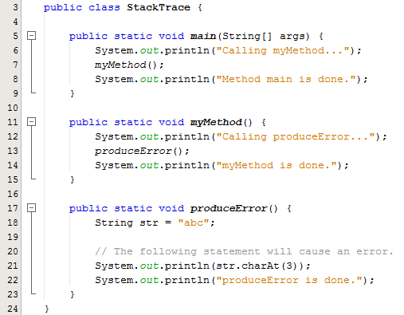
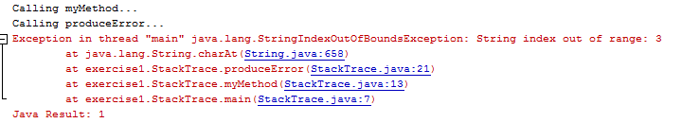
Example
The stack trace shows the method that was executing when an exception occurred i.e. line 21
It also shows all of the methods that were called in order to execute the produceError method

Slide 10
Uncaught Exceptions
When an exception is thrown, it cannot be ignored.
It must be handled by the program, or by the default exception handler.
When the code in a method throws an exception:
  normal execution of that method stops, and
  the JVM searches for a compatible exception handler inside the method.

Slide 11
Uncaught Exceptions
If there is no exception handler inside the method:
  control of the program is passed to the previous method in the call stack.
  If that method has no exception handler, then control is passed again, up the call stack, to the previous method.
If control reaches the main method:
  the main method must either handle the exception, or
  the program is halted and the default exception handler handles the exception.

Slide 12
Checked and Unchecked Exceptions
There are two categories of exceptions:
  unchecked
  checked.
Unchecked exceptions are those that are derived from the Error class or the RuntimeException class.
Exceptions derived from Error are thrown when a critical error occurs, and should not be handled.
RuntimeException serves as a superclass for exceptions that result from programming errors.

Slide 13
Checked and Unchecked Exceptions
These exceptions can be avoided with properly written code.
Unchecked exceptions, in most cases, should not be handled.
All exceptions that are not derived from Error or RuntimeException are checked exceptions.

Slide 14
Checked and Unchecked Exceptions
If the code in a method can throw a checked exception, the method:
  must handle the exception, or
  it must have a throws clause listed in the method header.
The throws clause informs the compiler what exceptions can be thrown from a method.

Slide 15
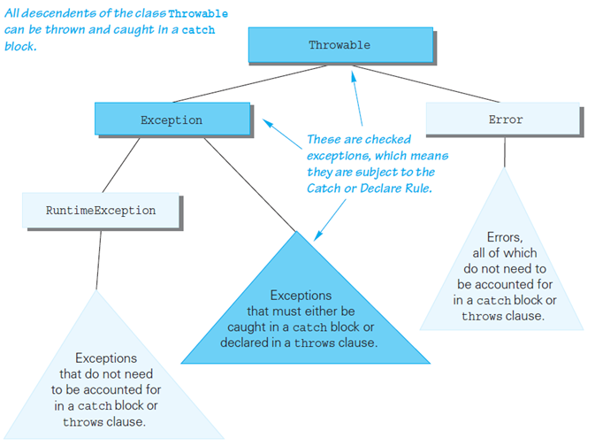
Checked and Unchecked Exceptions

Slide 16
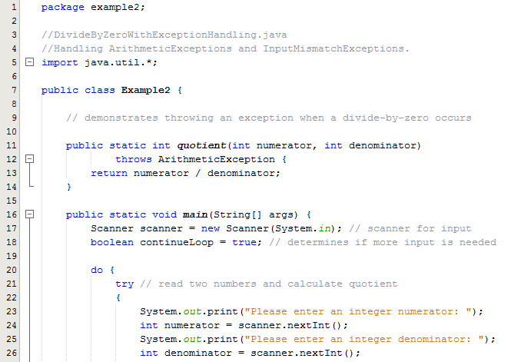
Example using throws

Slide 17
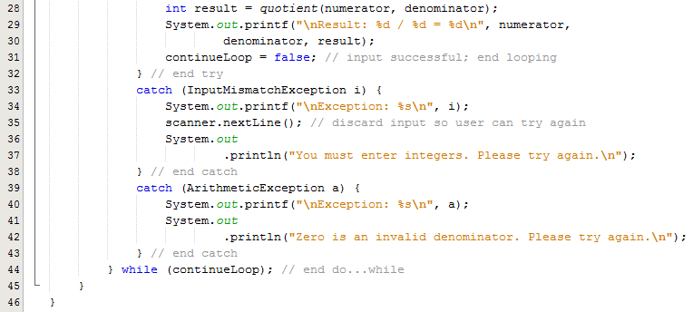
Example using throws

Slide 18

Checked and Unchecked Exceptions
The code in this method is capable of throwing exceptions.
The keyword throws can be written at the end of the method header, followed by a list of the types of exceptions that the method can throw.

Slide 19
Throwing Exceptions
You can write code that:
  throws one of the standard Java exceptions, or
  an instance of a custom exception class that you have designed.
The throw statement is used to manually throw an exception.
  throw new ExceptionType(MessageString);
The throw statement causes an exception object to be created and thrown.

Slide 20
Creating Exception Classes
You can create your own exception classes by deriving them from the Exception class or one of its derived classes.
Example:
  BankAccount.java
  NegativeStartingBalance.java
  AccountTest.java

Slide 21
Creating Exception Classes
Some examples of exceptions that can affect a bank account:
  A negative starting balance is passed to the constructor.
  A negative interest rate is passed to the constructor.
  A negative number is passed to the deposit method.
  A negative number is passed to the withdraw method.
  The amount passed to the withdraw method exceeds the account’s balance.
We can create exceptions that represent each of these error conditions.

Slide 22
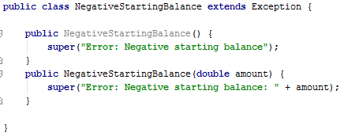
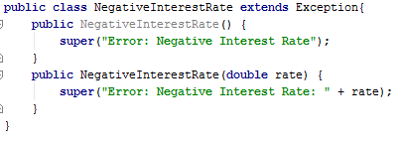
Example – Create an Exception Class
User defined exceptions in java are also known as Custom exceptions. Most of the time when we are developing an application in java, we often feel a need to create and throw our own exceptions.
User defined exception needs to inherit (extends) Exception class in order to act as an exception.

Slide 23
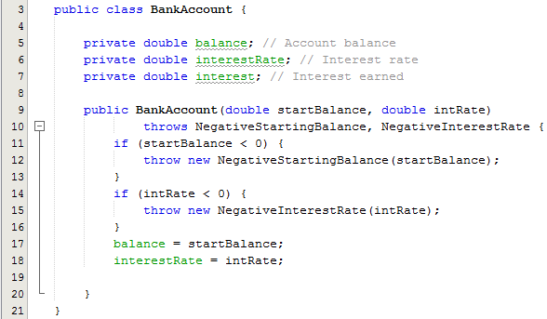
Example – Use of throws and throw
Throws: Throws declares that your method is capable of throwing an exception but it does not handle the exception that must be specified by using “throws” class. See Line 10
Throw: Throw keyword does work to throw an exception. When a user defined exception is to be raised, throw keyword is used – See Lines 12 and 15

Slide 24
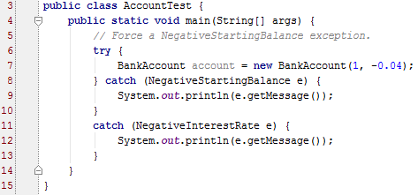
Example – Test Class
These two exceptions now need to handled
This is done using a try catch block
getMessage is a method available to Exception objects. As its name suggests, it gets the error message associated with the Exception.

